Slide 1
ALTPRO
Origin of your safety.
2024

Slide 2
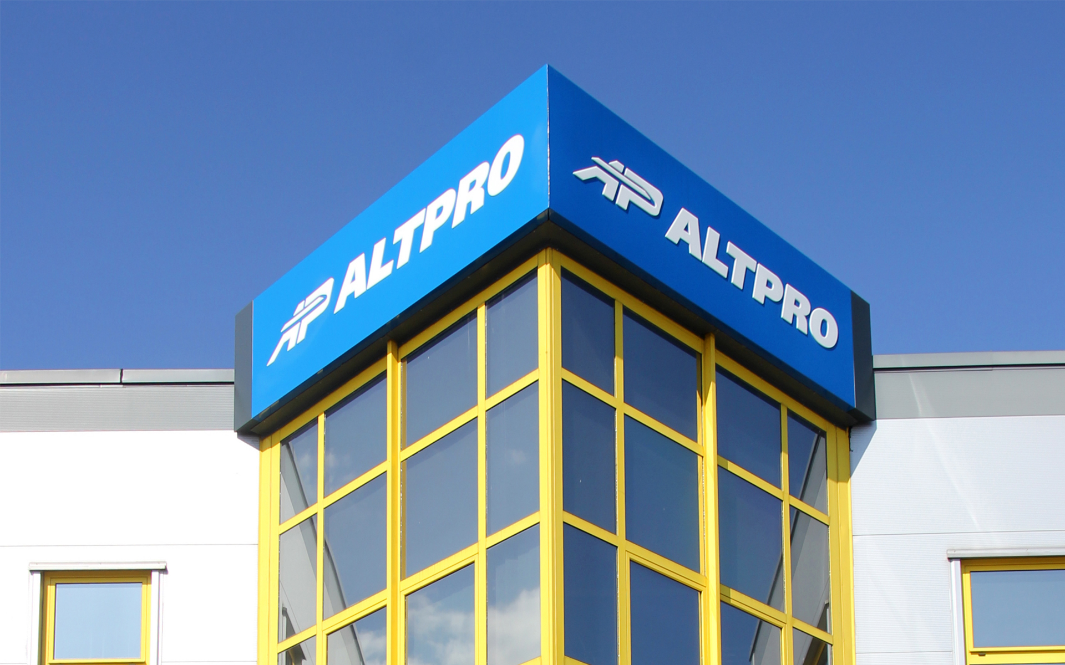
About us
ALTPRO is a specialized signalling company which provides safety critical signalling systems used on railway infrastructure and rolling stock.
More than 30 years of experience
Export to more than 50 countries
More than 200 employees
100% privately owned
Own research and development

Slide 3
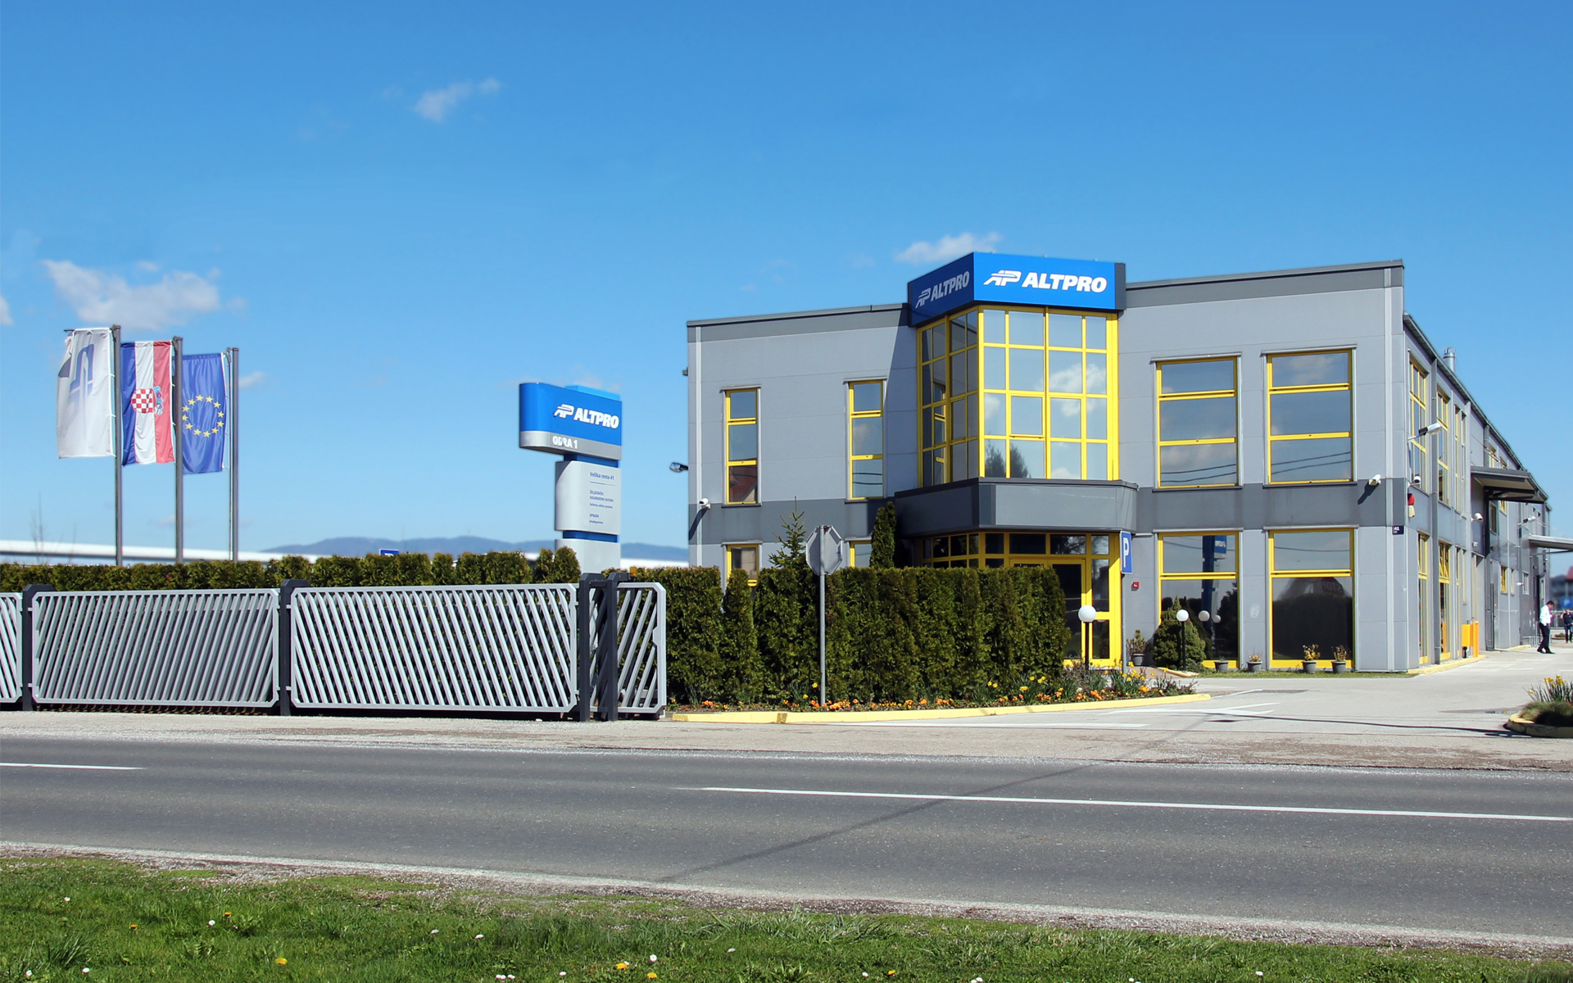
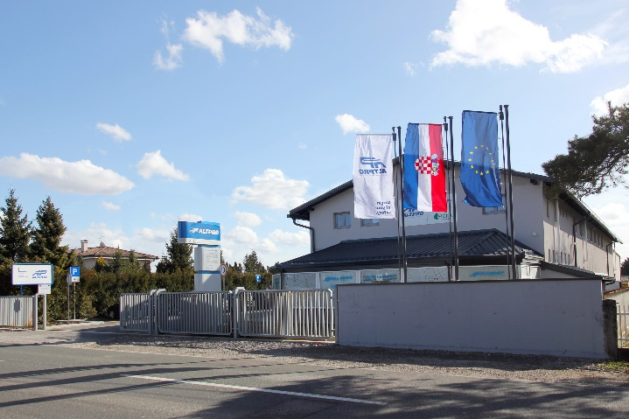
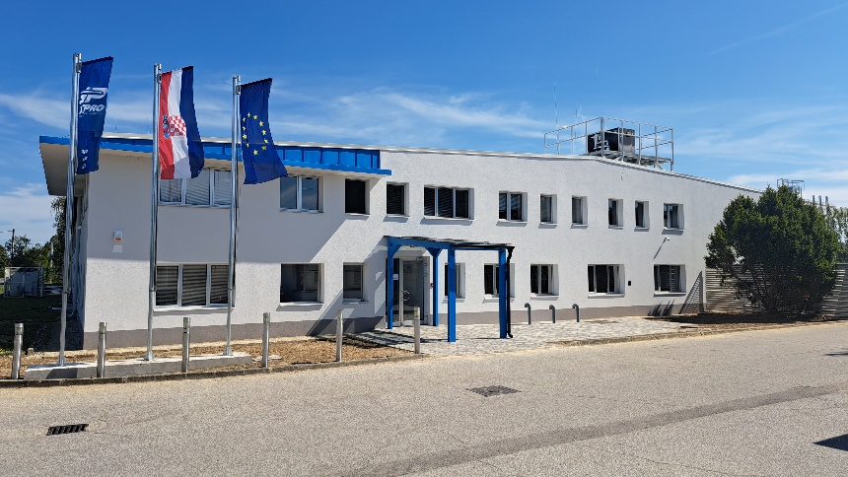
Locations
ALTPRO operates at 5 locations in two countries
Main locations are Research and innovation centers “ODRA 1” and “ODRA 2” in Zagreb as well as Production facility “Gorica”
Odra 1
Odra 2
Gorica

Slide 4
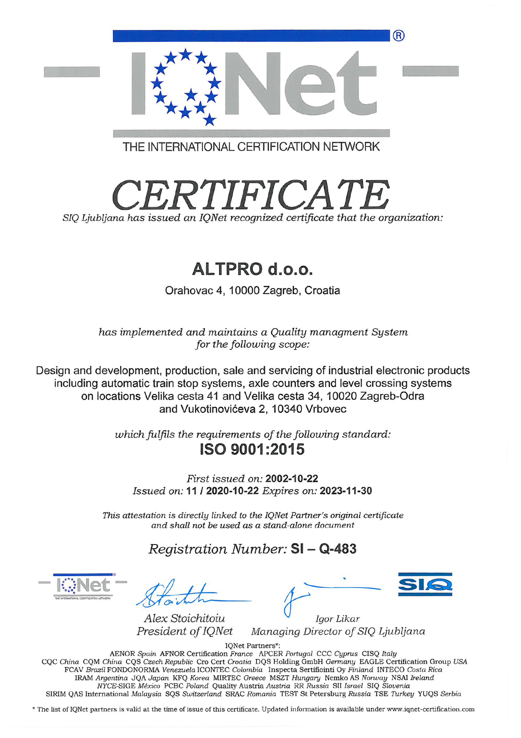
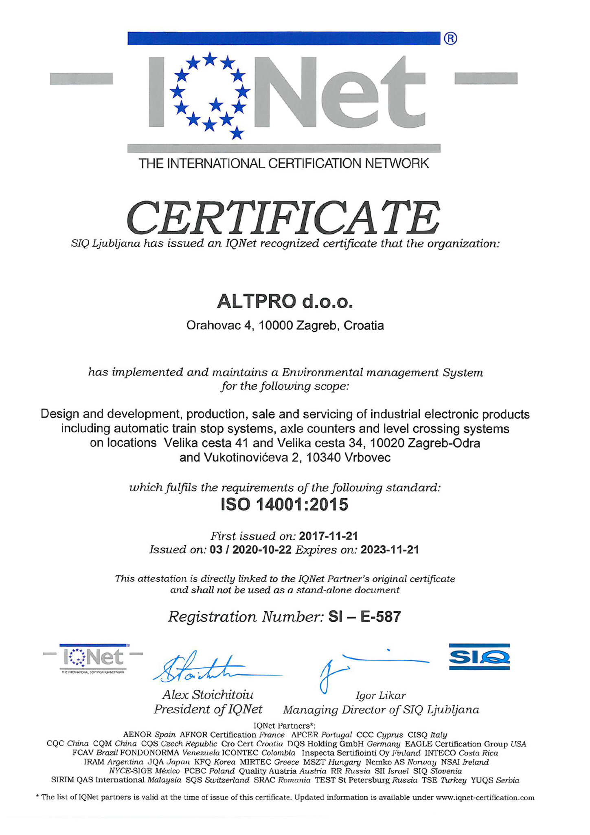
Quality standards - company
ISO 9001 – Quality management system
ISO 14001 – Enviromental management system
IRIS – International Railway Industry Standard (in preparation)

Slide 5
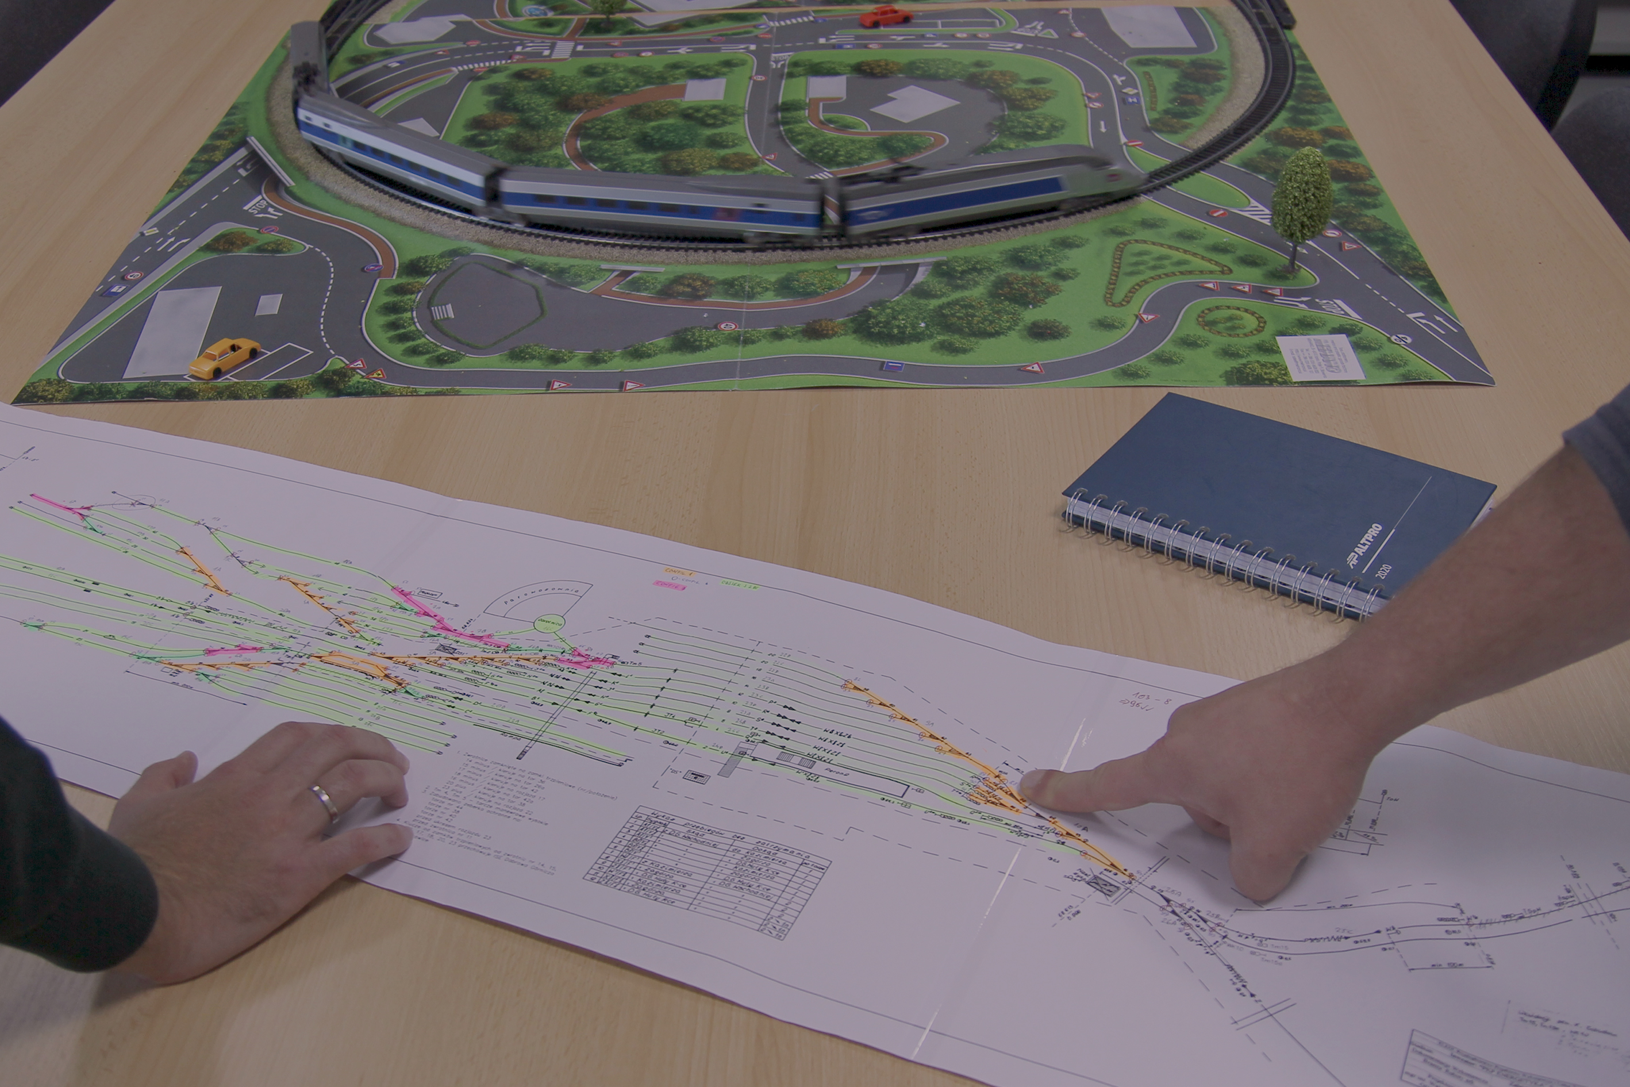
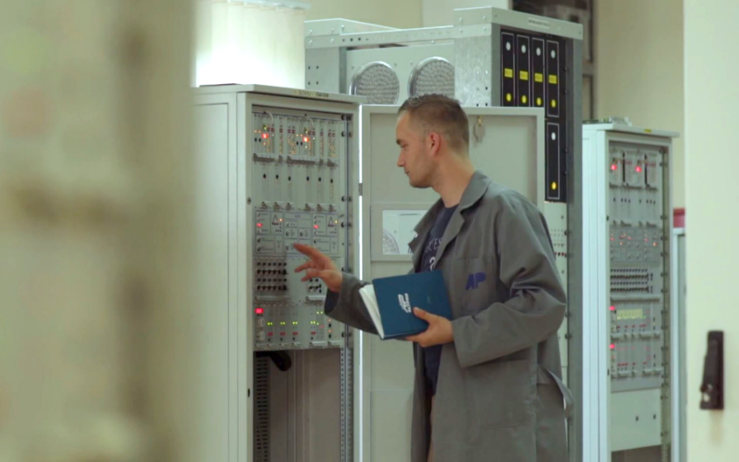
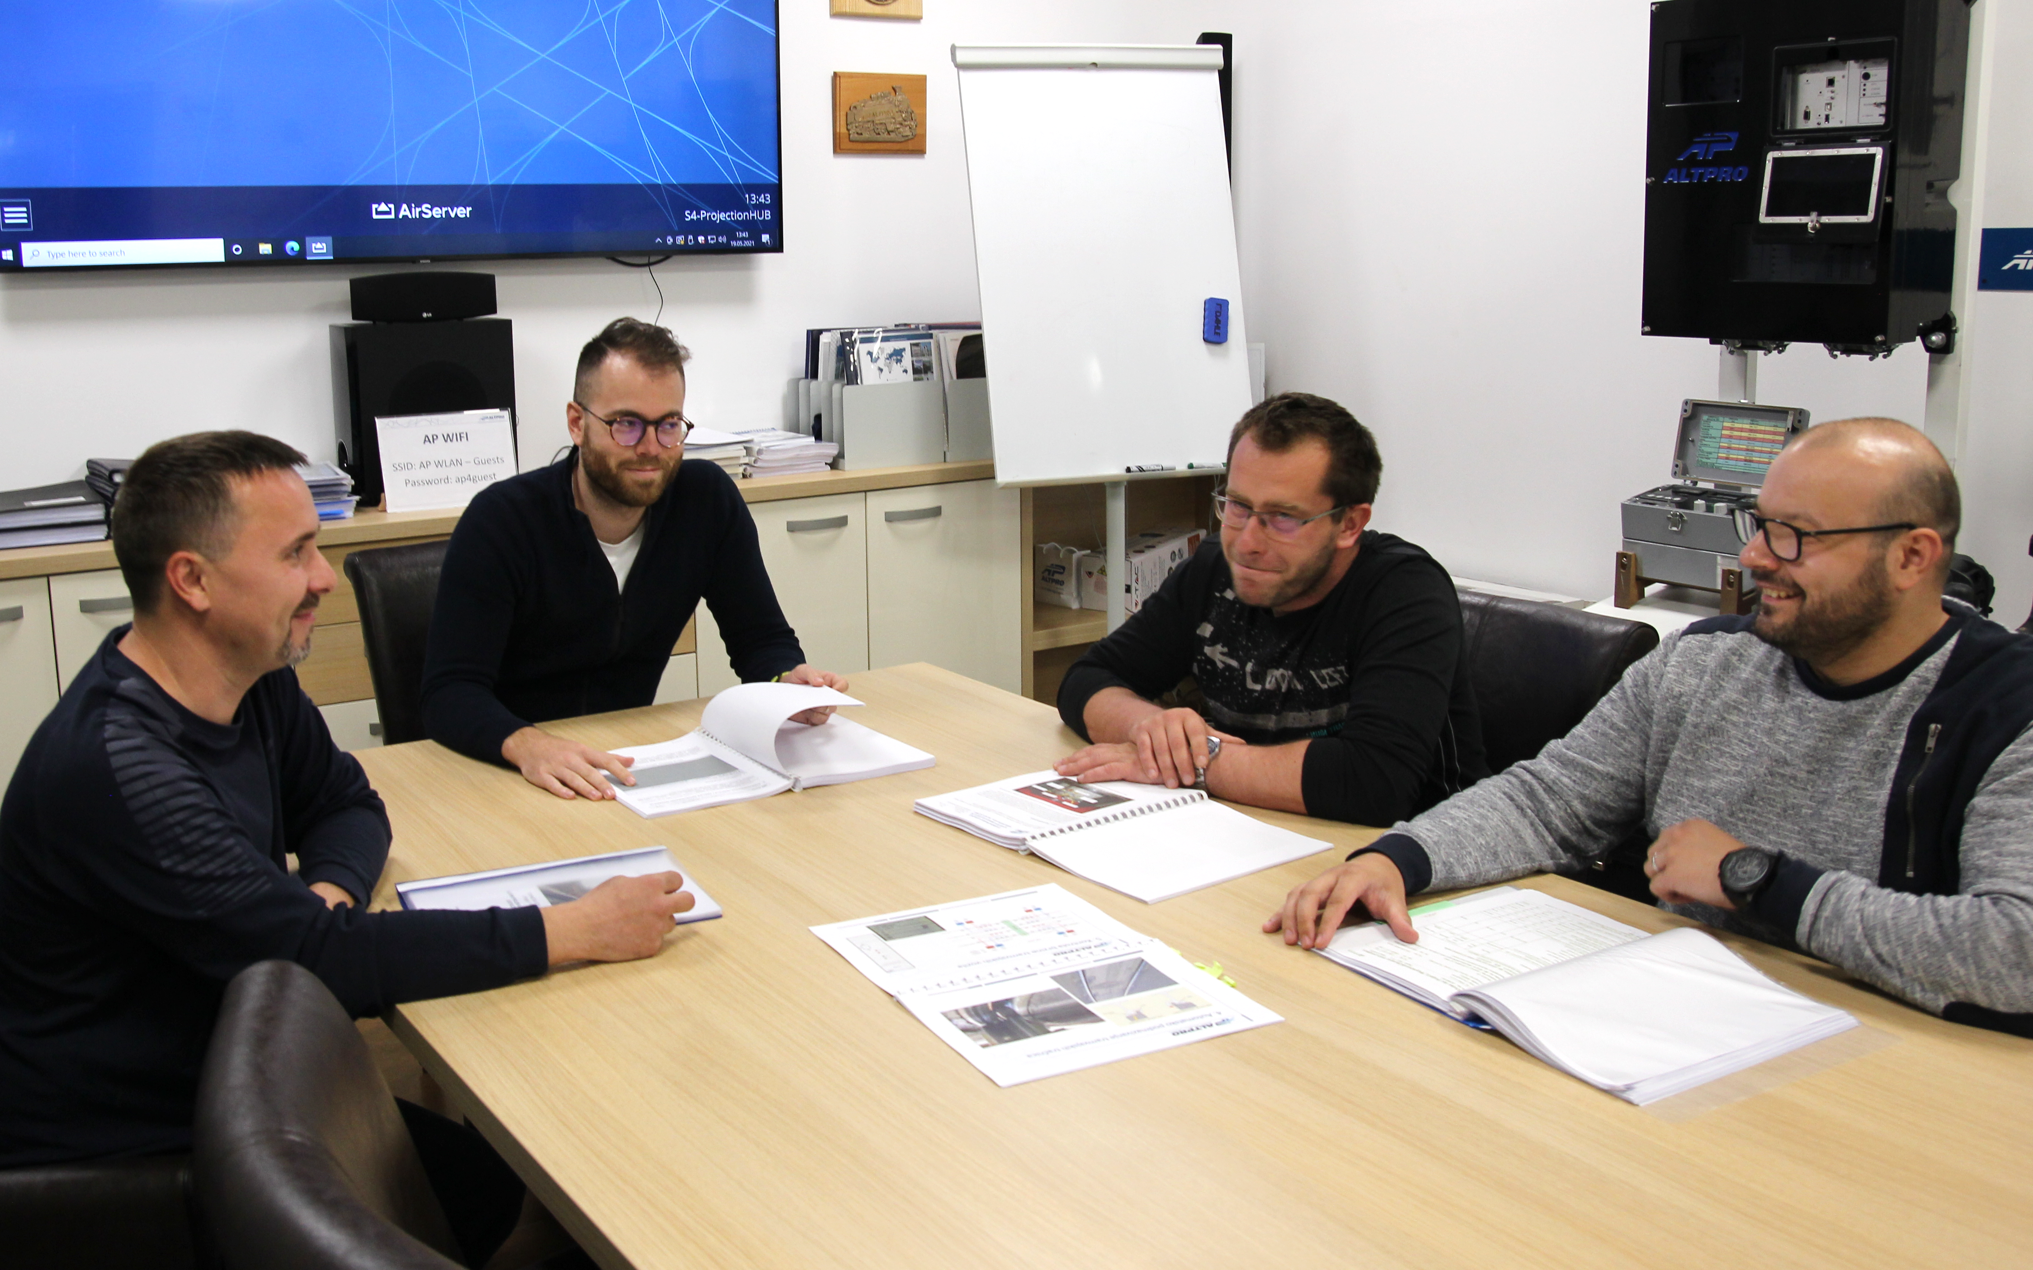
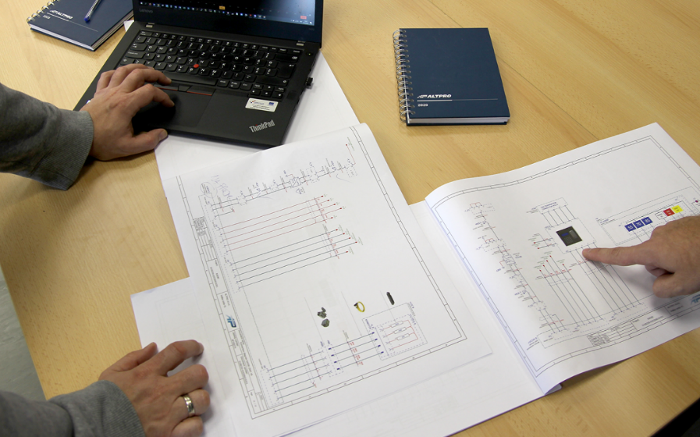
MAIN DEPARTMENTS
Project management

Slide 6
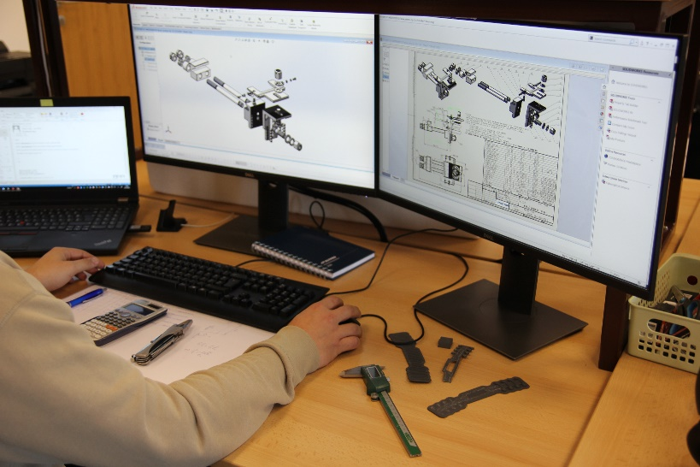
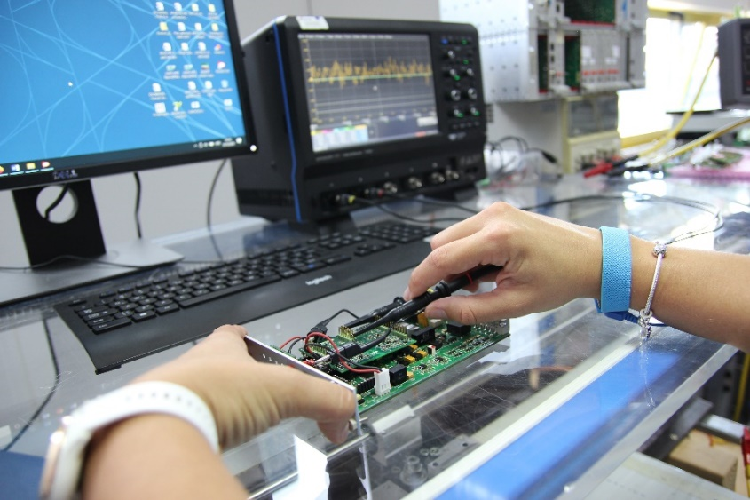
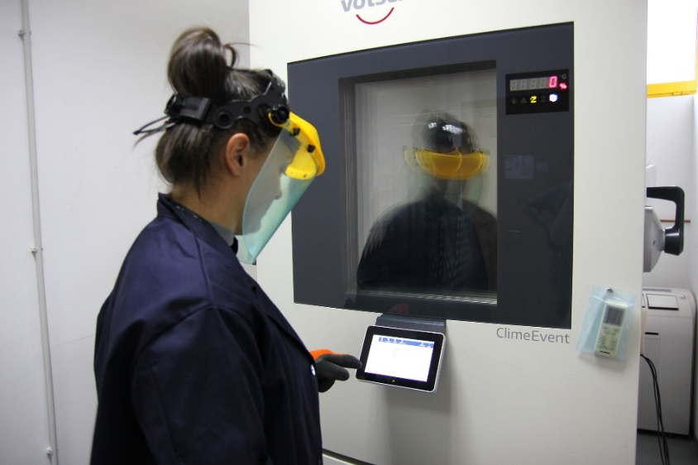
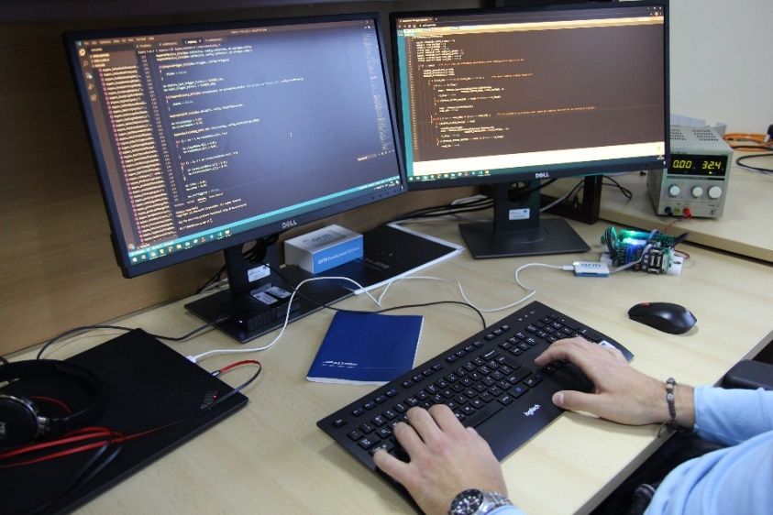
MAIN DEPARTMENTS
Research and development

Slide 7
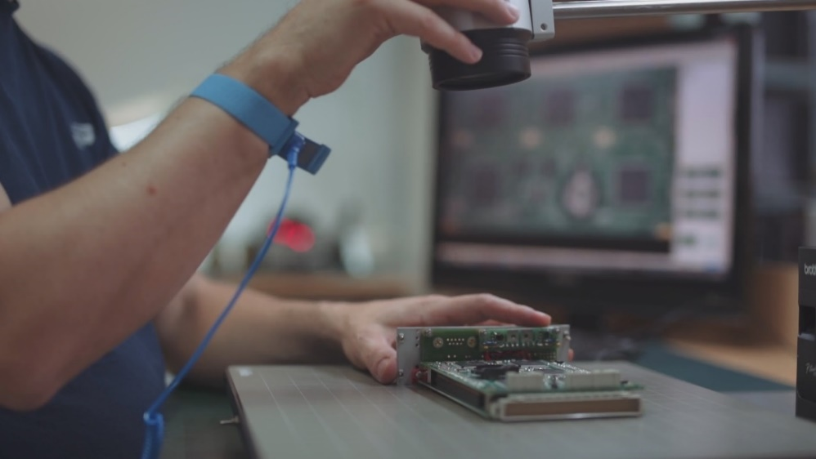
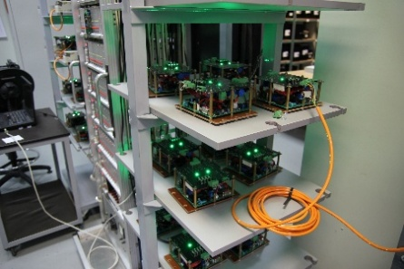
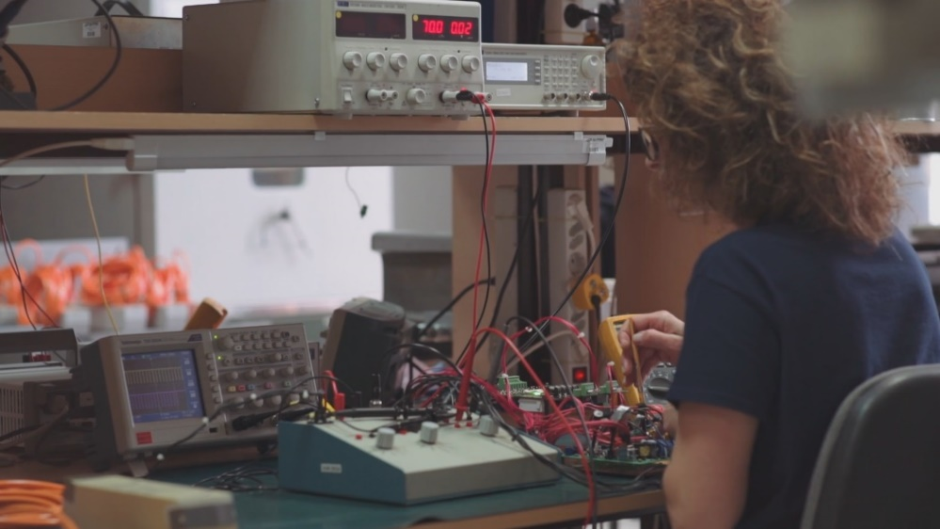
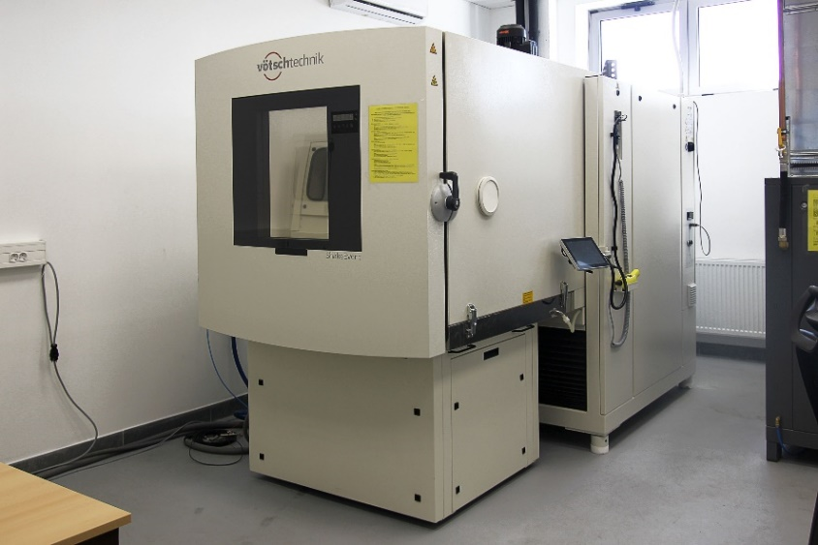
MAIN DEPARTMENTS
Quality control

Slide 8
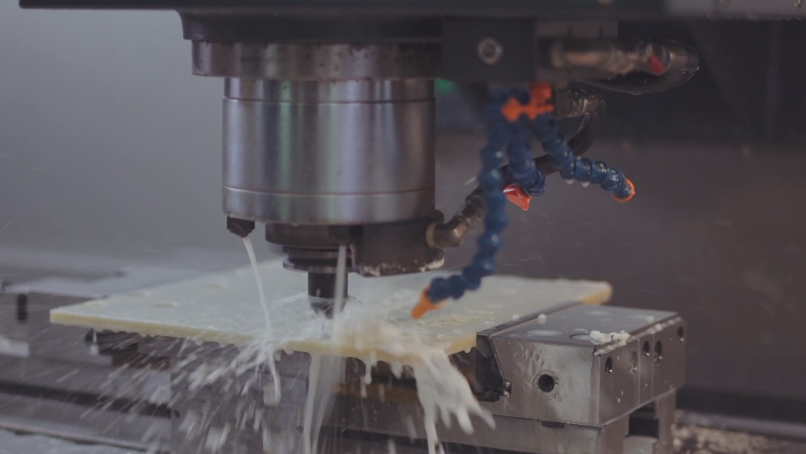
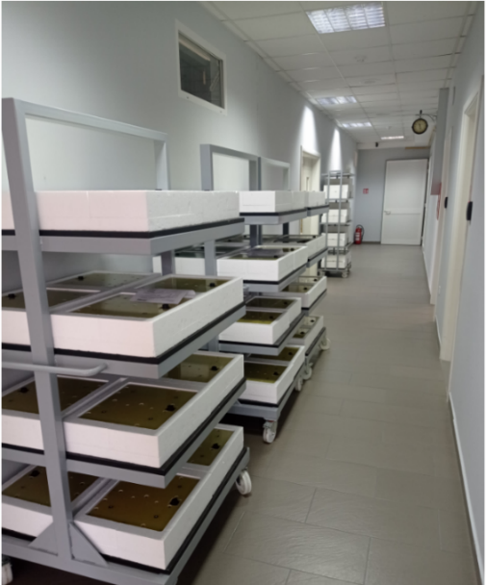
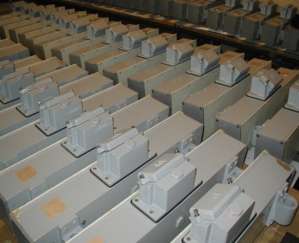
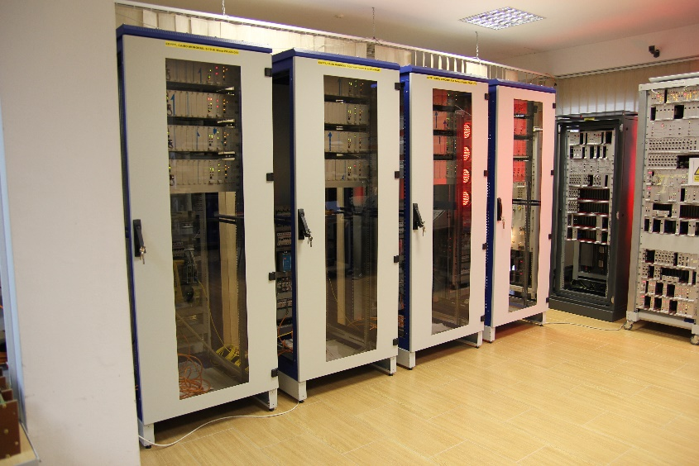
MAIN DEPARTMENTS
Production

Slide 9
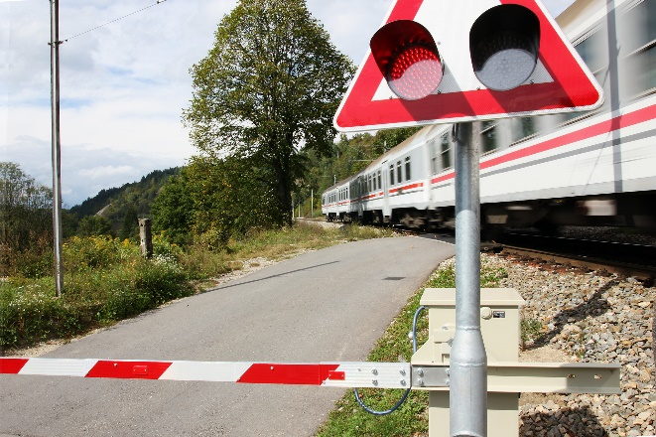
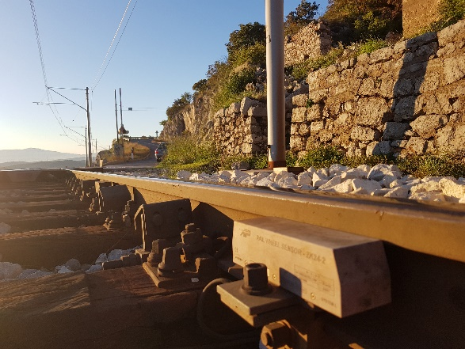


Signalling systems for infrastructure
Core competence
Research, development and production of signalling systems
Integration and partnering
Signalling systems, telecom, power supply network, technical protection and video surveillance

Slide 10
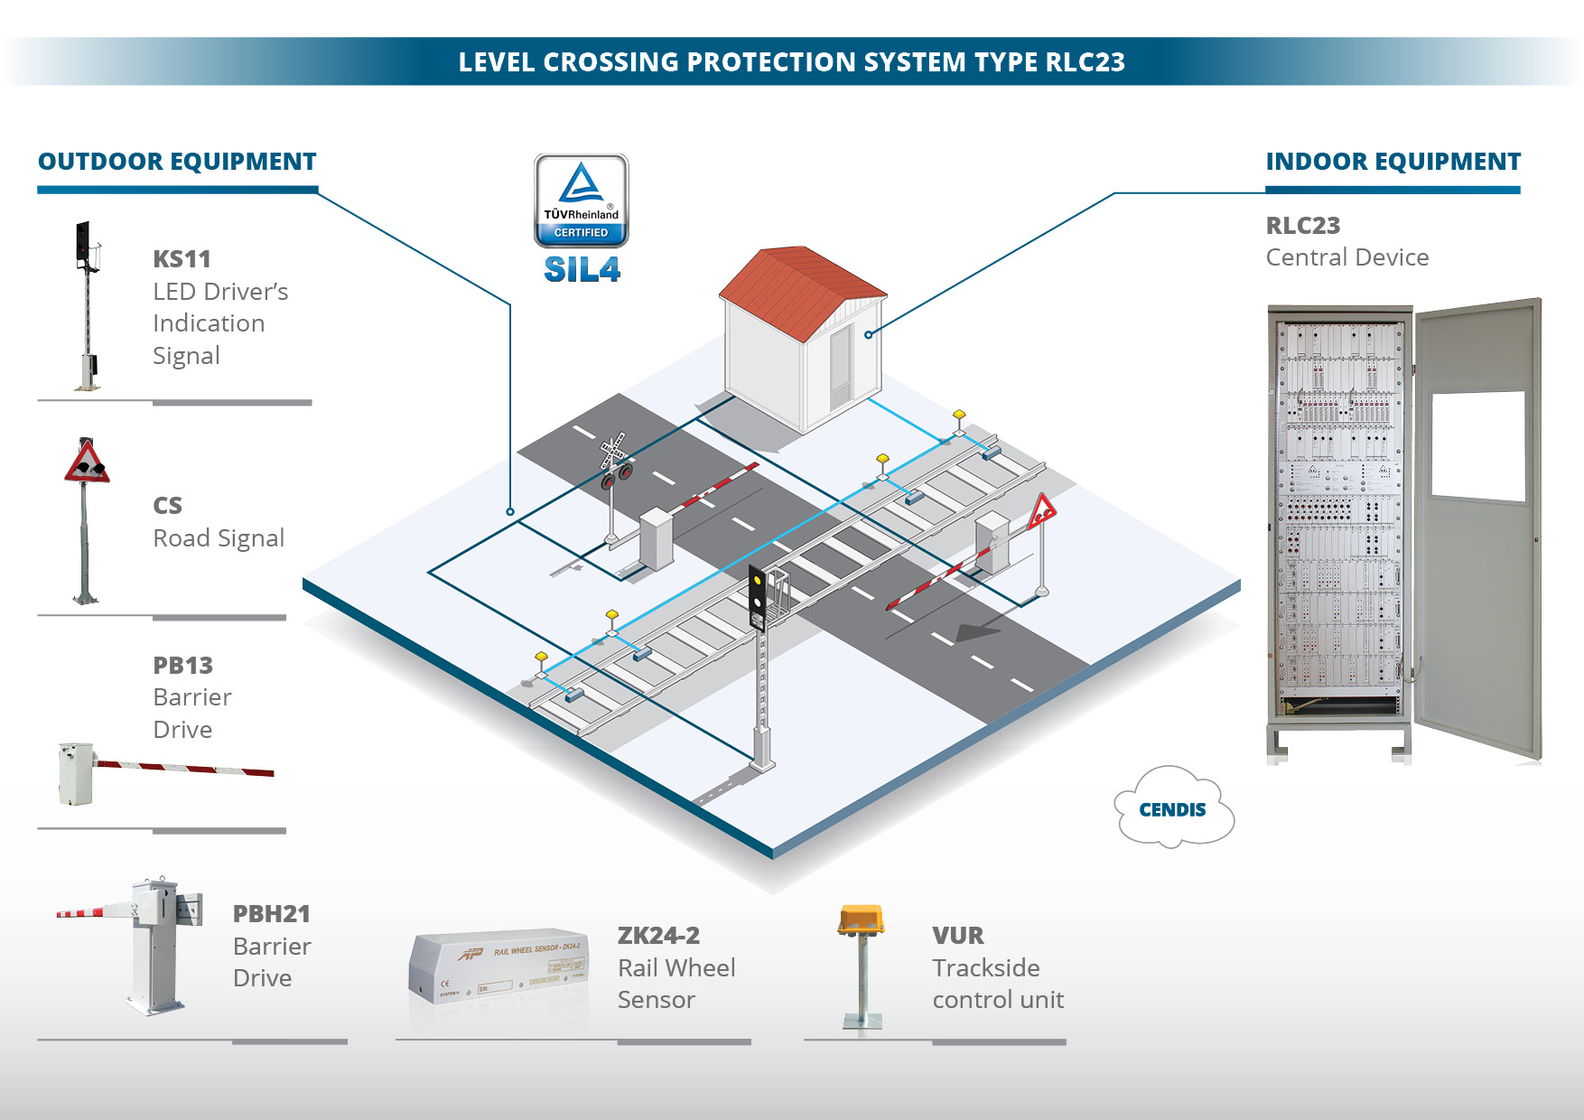

Slide 11
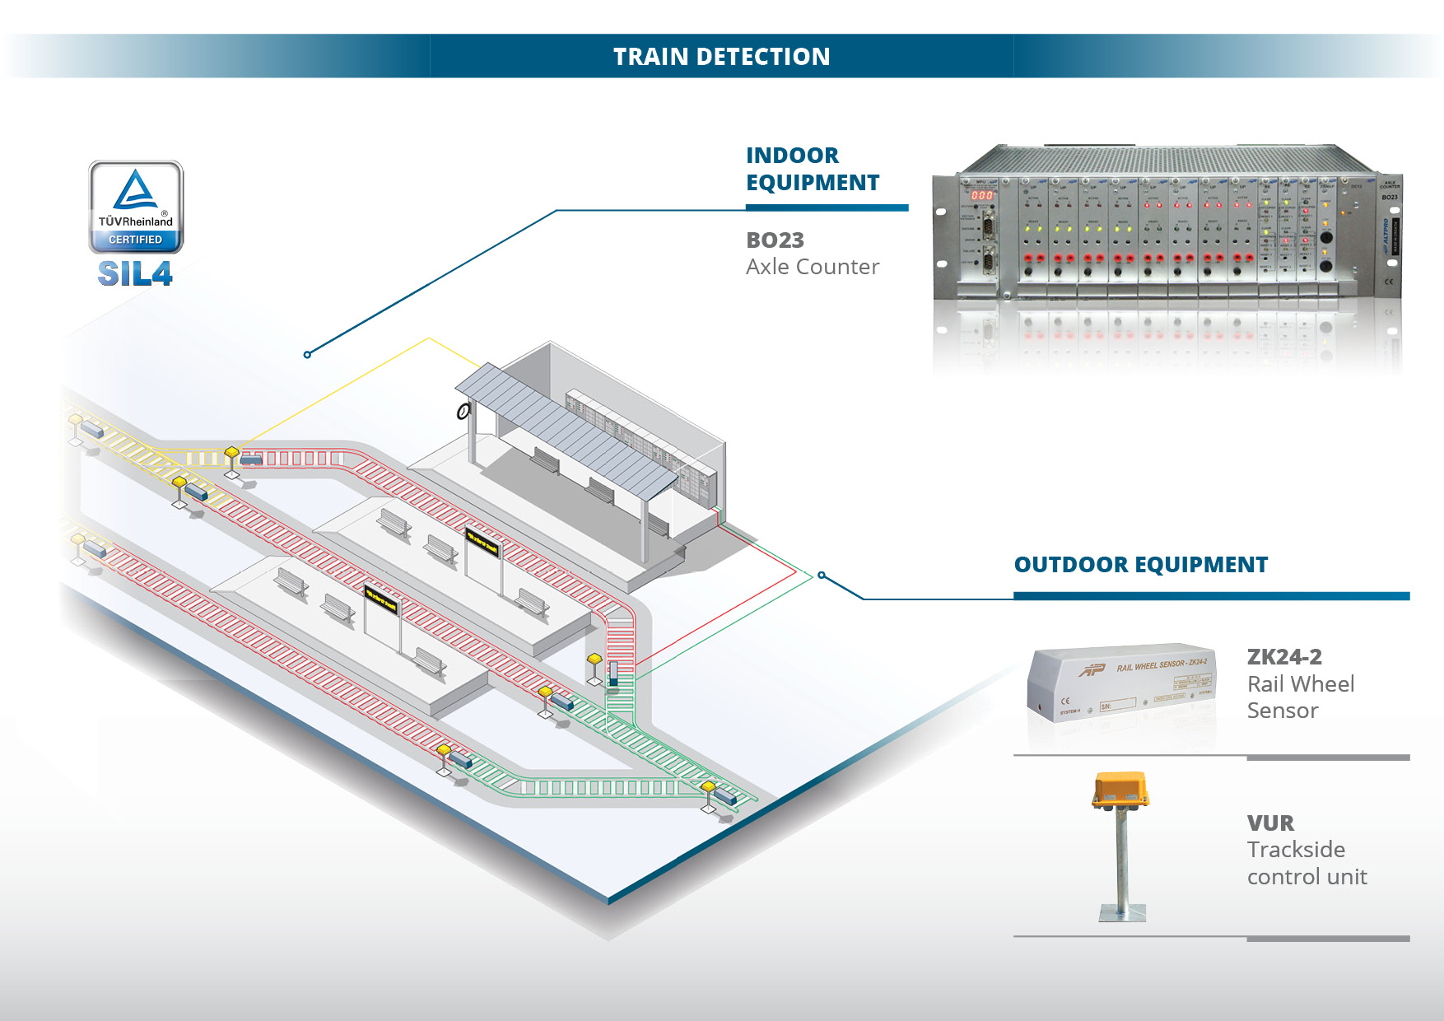

Slide 12
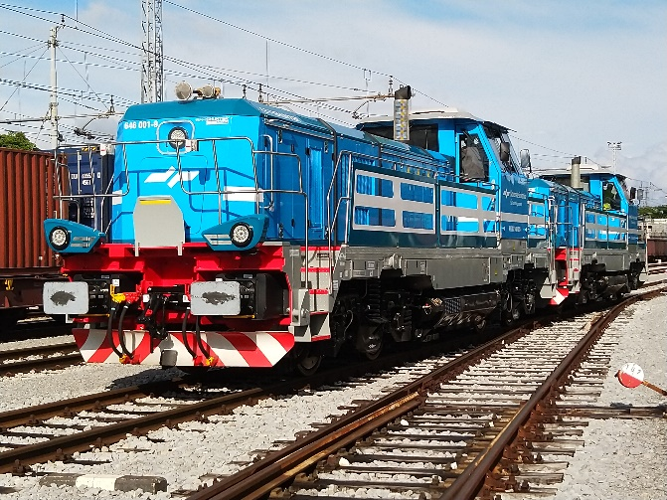
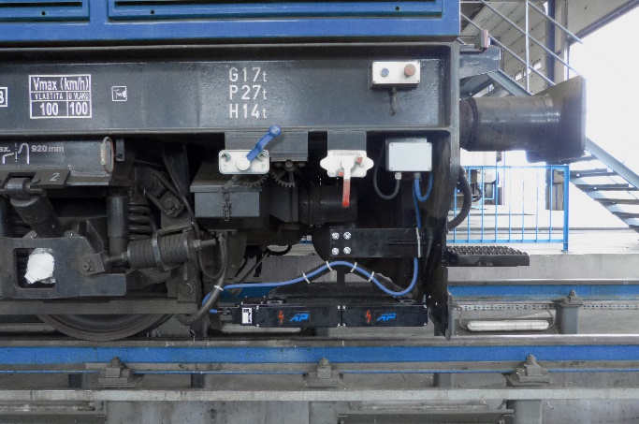
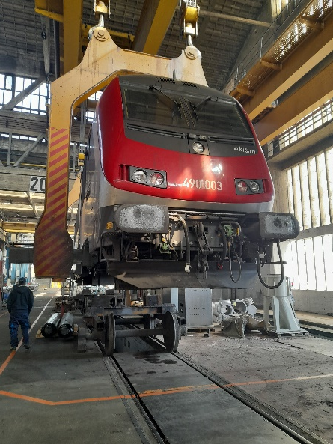
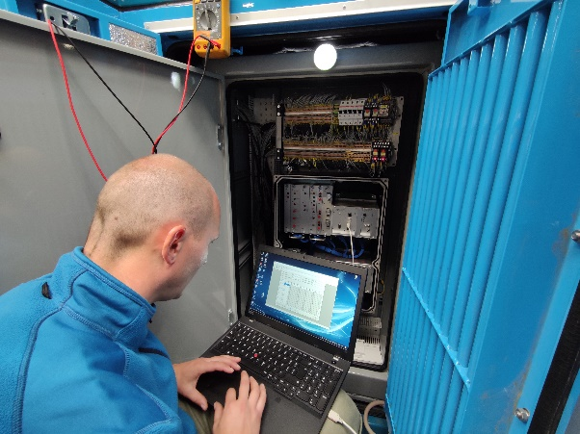
Integrated rolling stock solutions
Core competence
Research, development and production of INDUSI based ATP systems
Vehicle services
Market introduction, homologation support, preventive/corrective maintenance, spare parts management

Slide 13
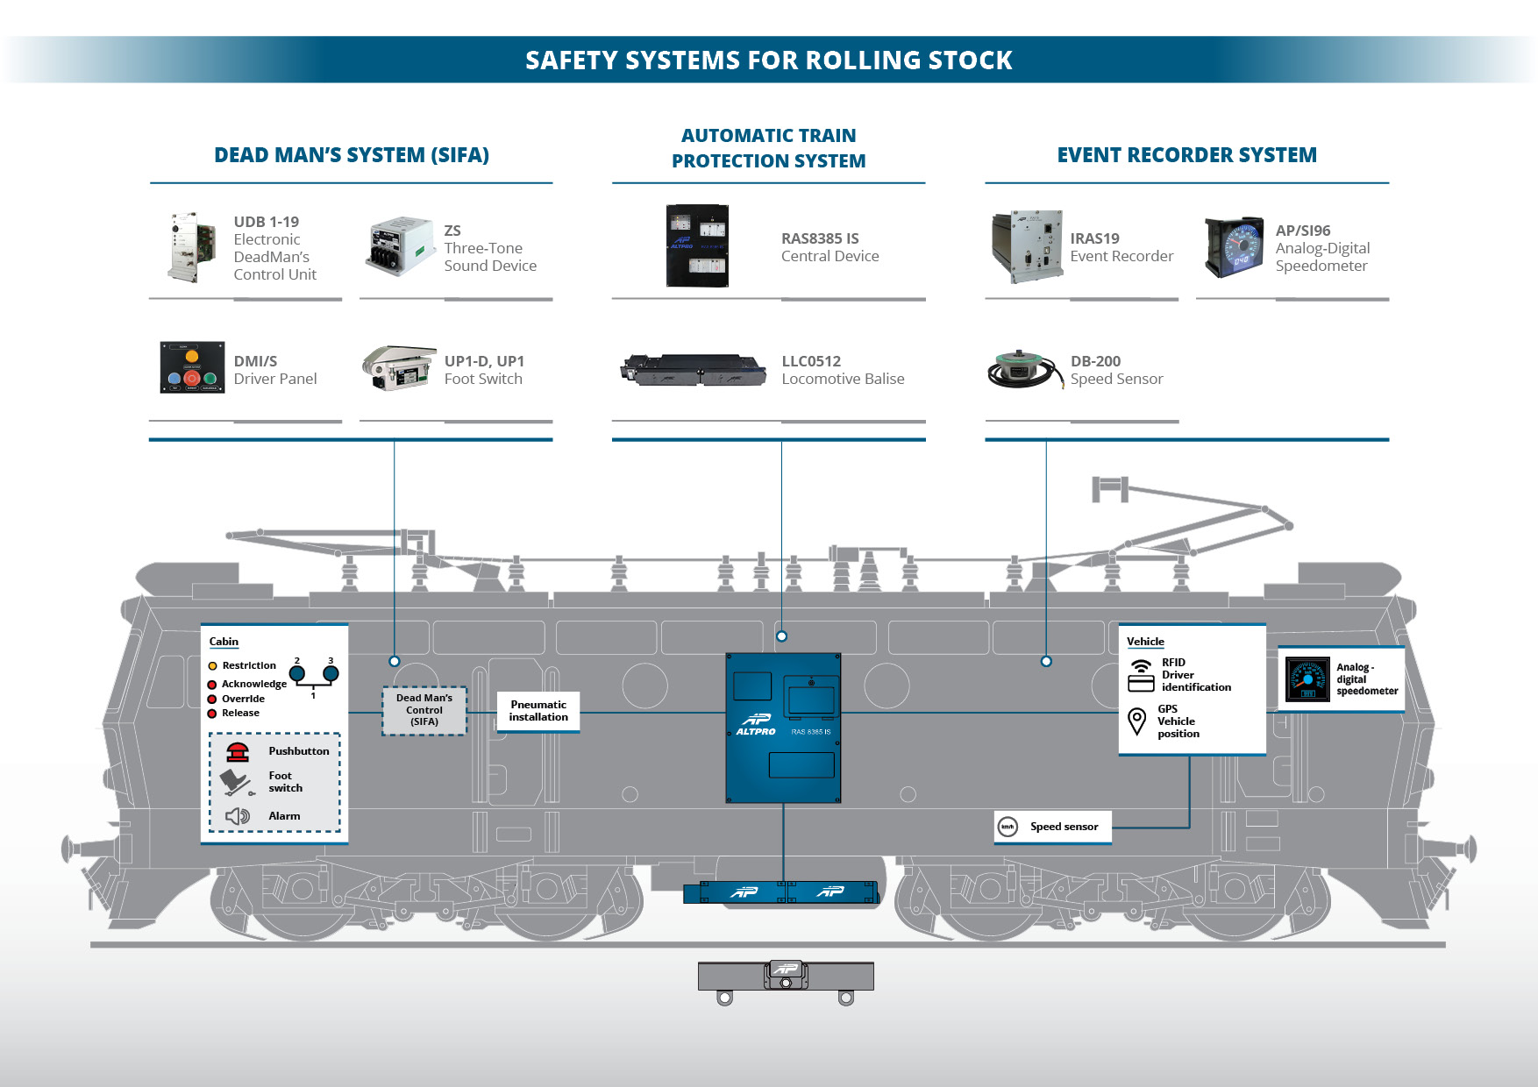

Slide 14
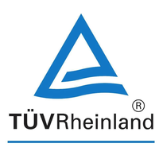


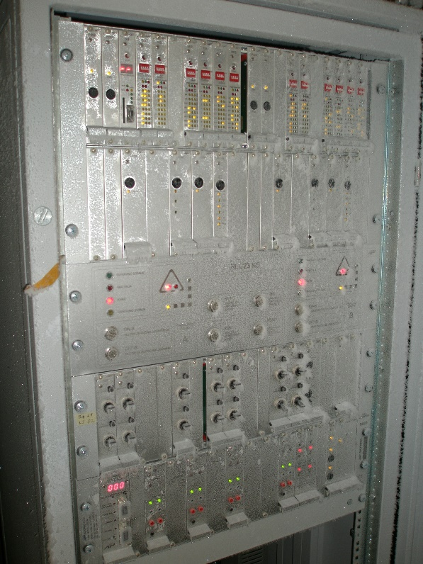
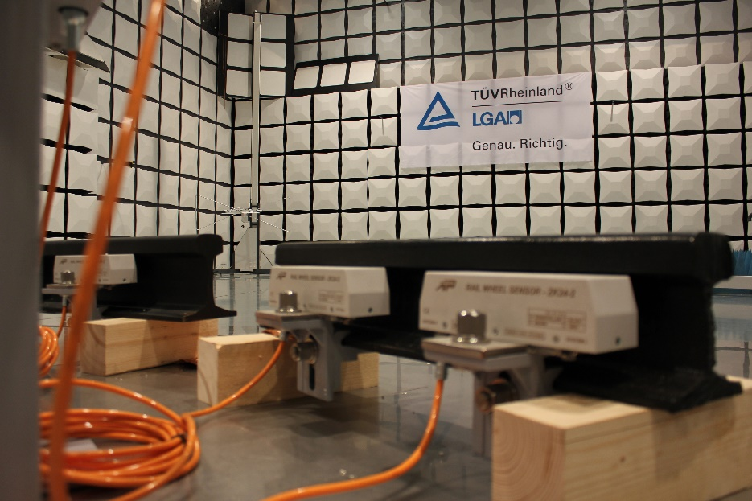
Quality standards - products
SIL 4 certification
Tests on low / high temperatures, EMI, vibration, shock…

Slide 15
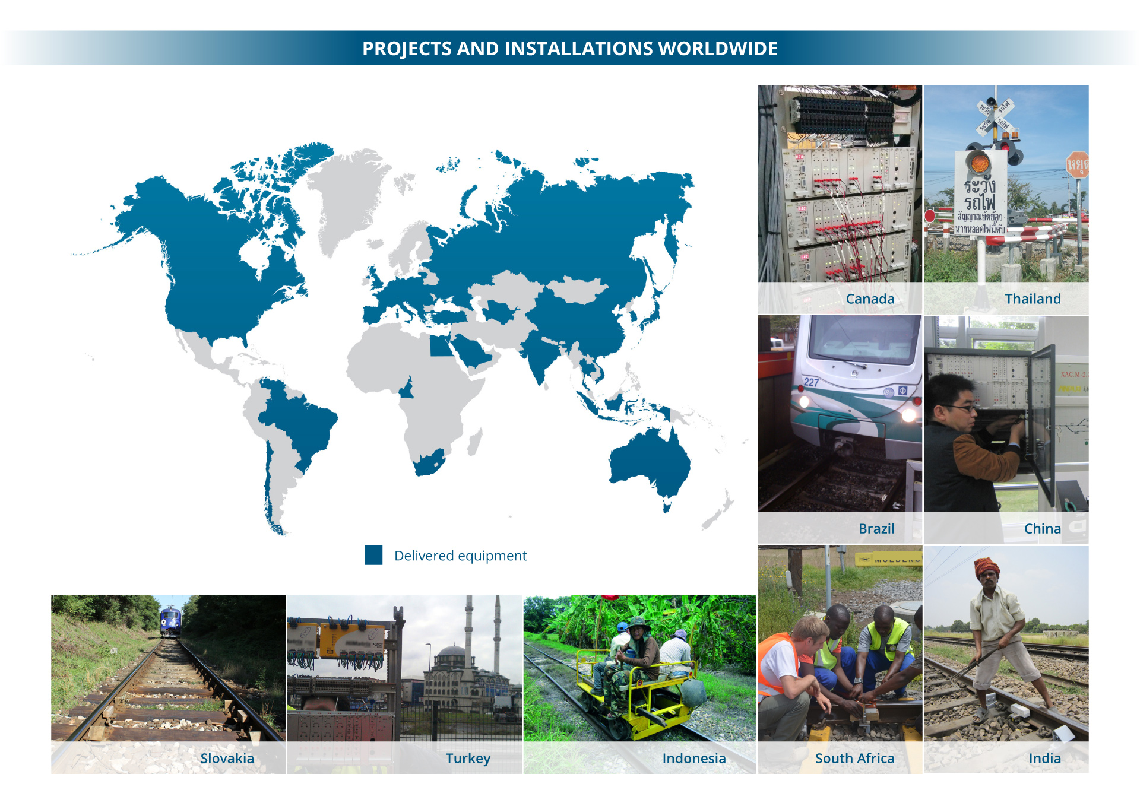
Worldwide presence

Slide 16
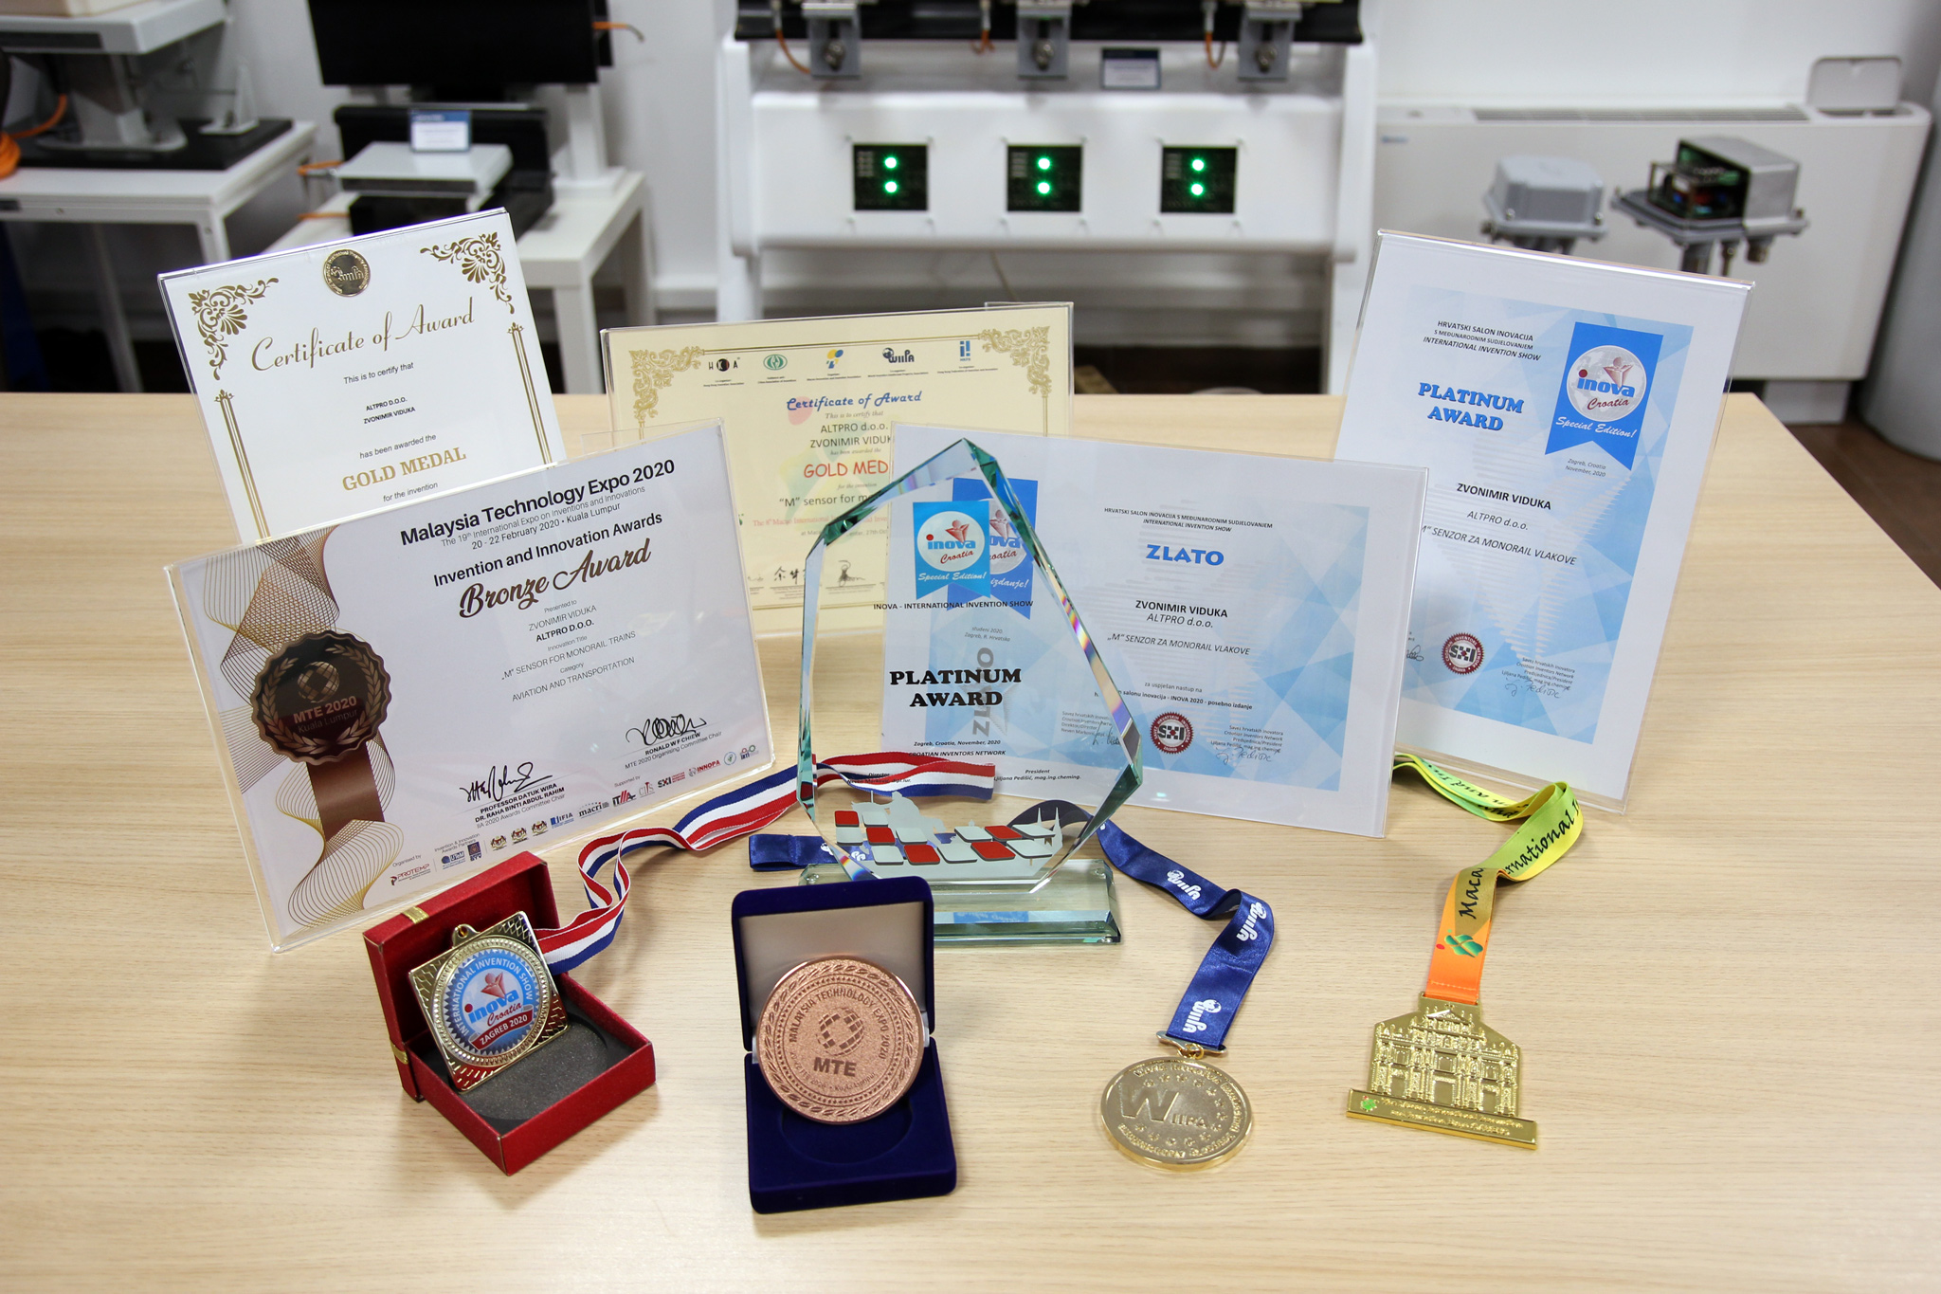
Awards and recognitions
Numerous state awards, medals, various recognitions of the Government of the Republic of Croatia and innovations awards from all over the world

Slide 17






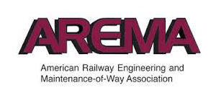
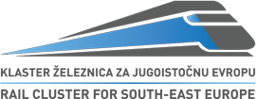
Memberships

Slide 18
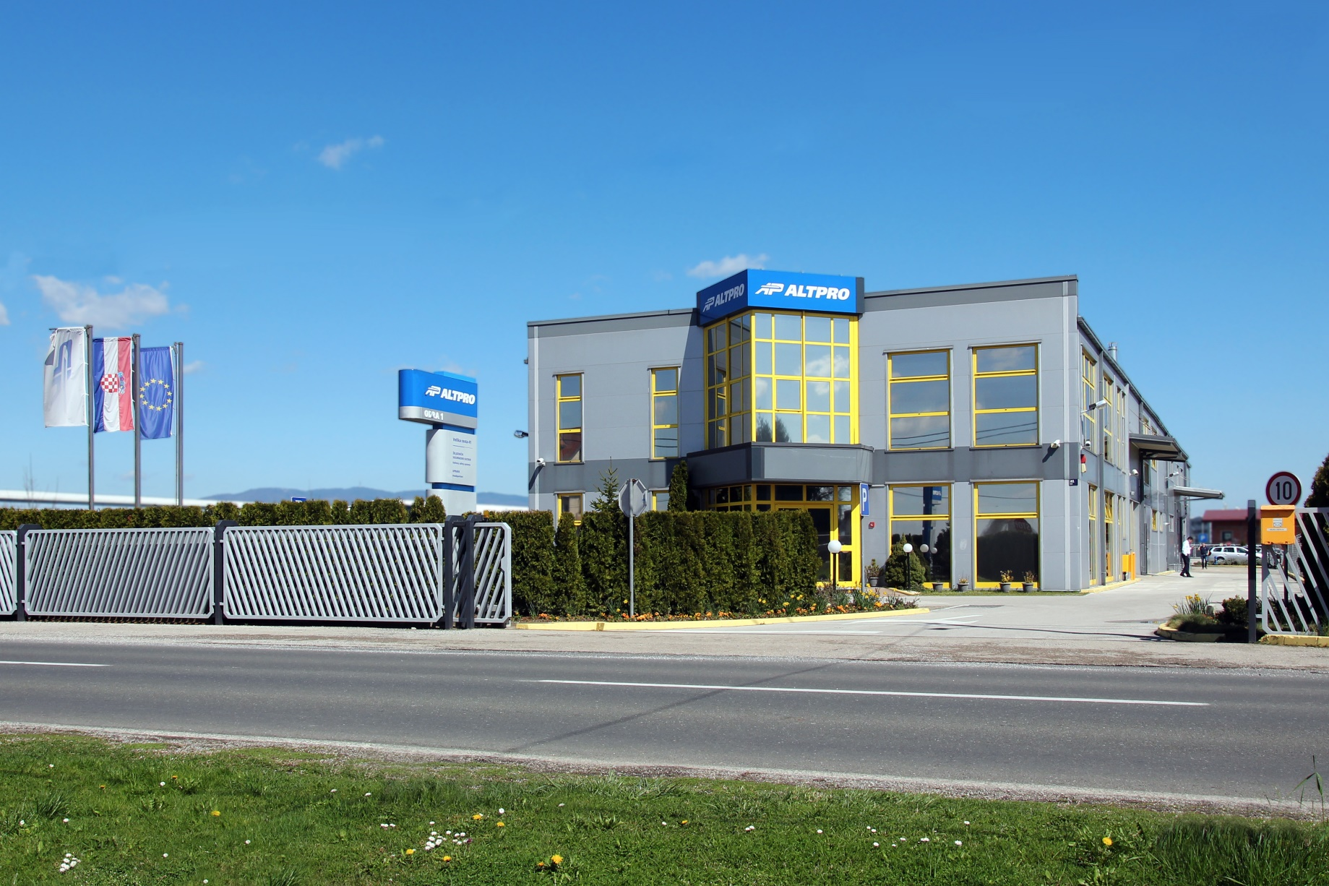
Thank you for your attention!

